Slide 1

FidMark: A Fiducial Marker Ontology For Semantically Describing Visual Markers
Maxim Van de Wynckel, Isaac Valadez, Beat Signer

Slide 2
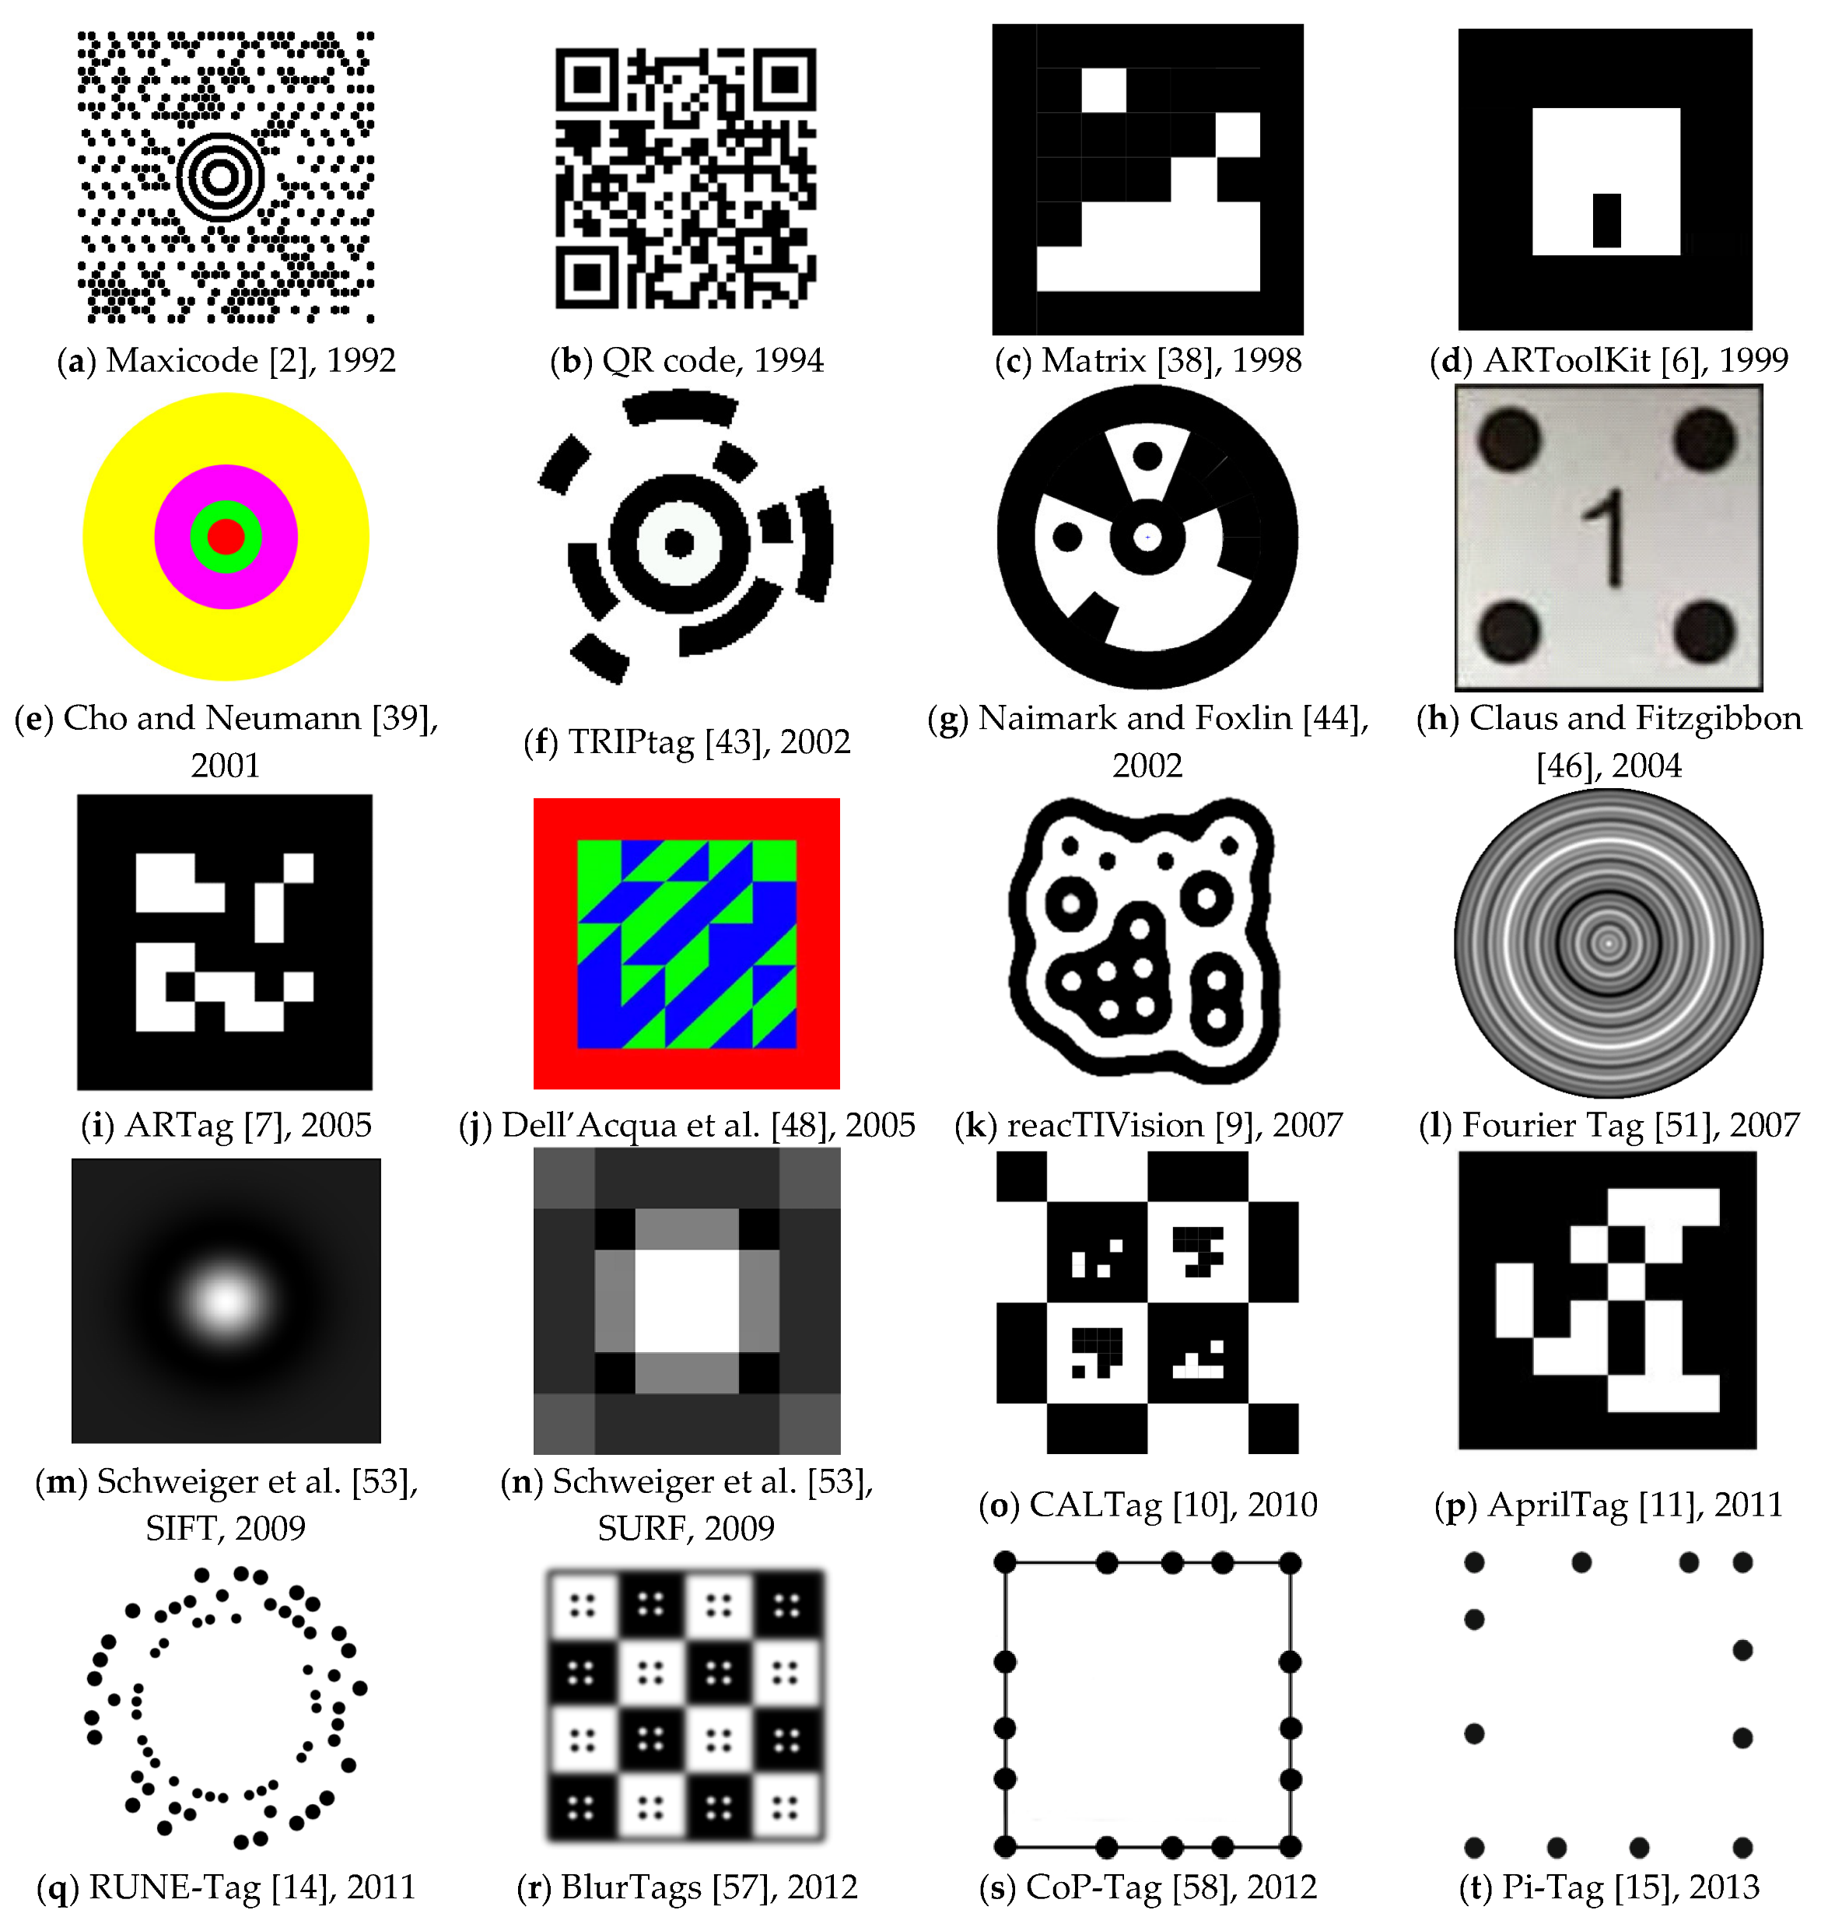
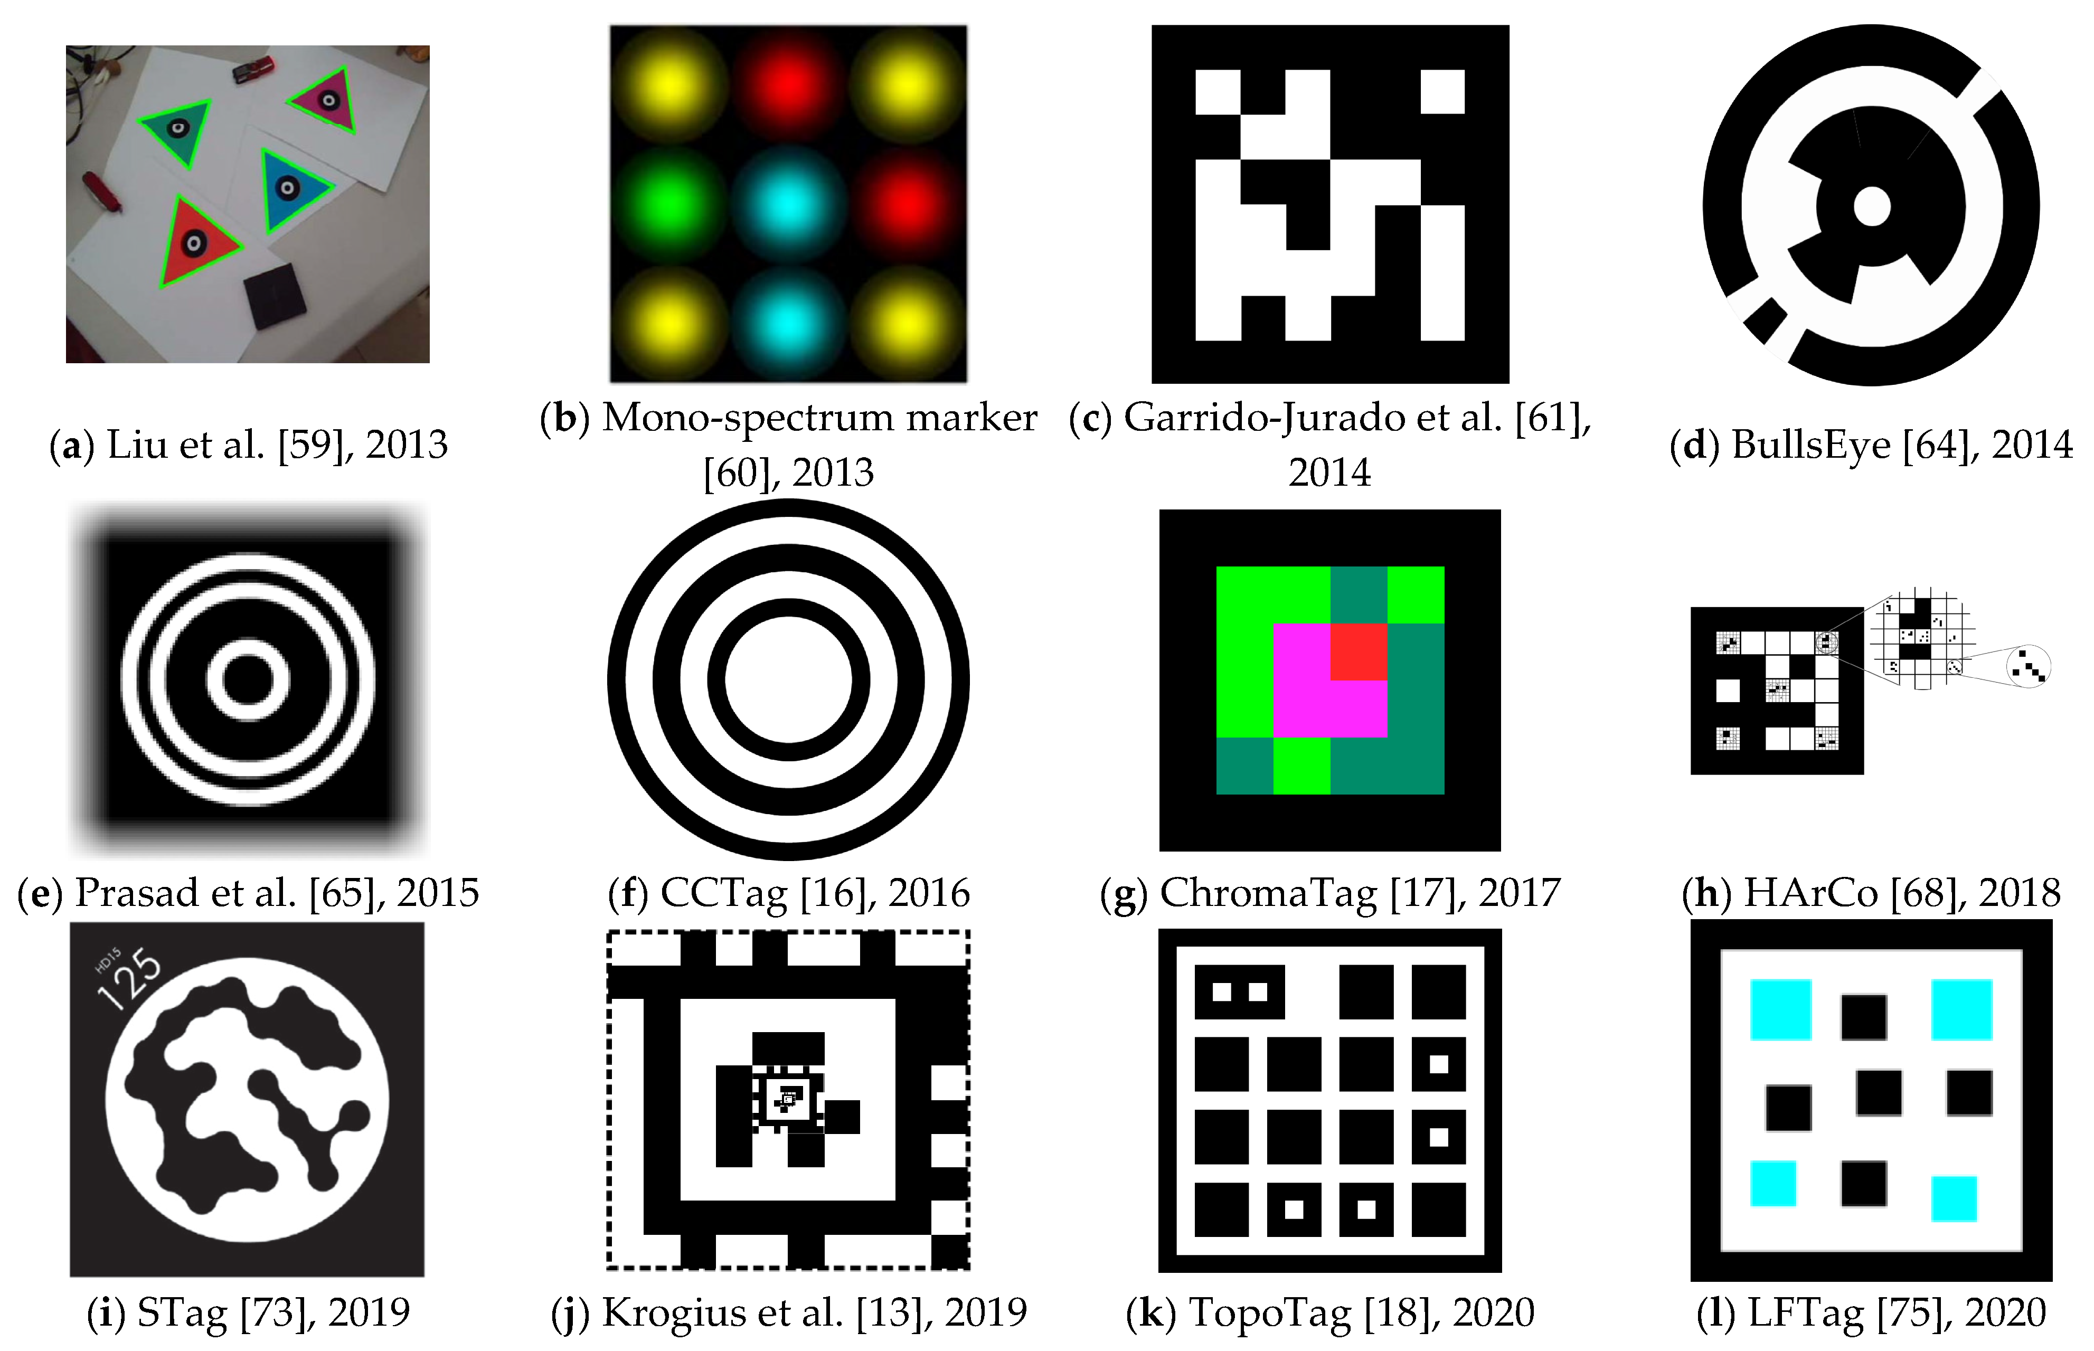
Background
Košťák, M.; Slabý, A. Designing a Simple Fiducial Marker for Localization in Spatial Scenes Using Neural Networks. Sensors 2021, 21, 5407. https://doi.org/10.3390/s21165407

Slide 3
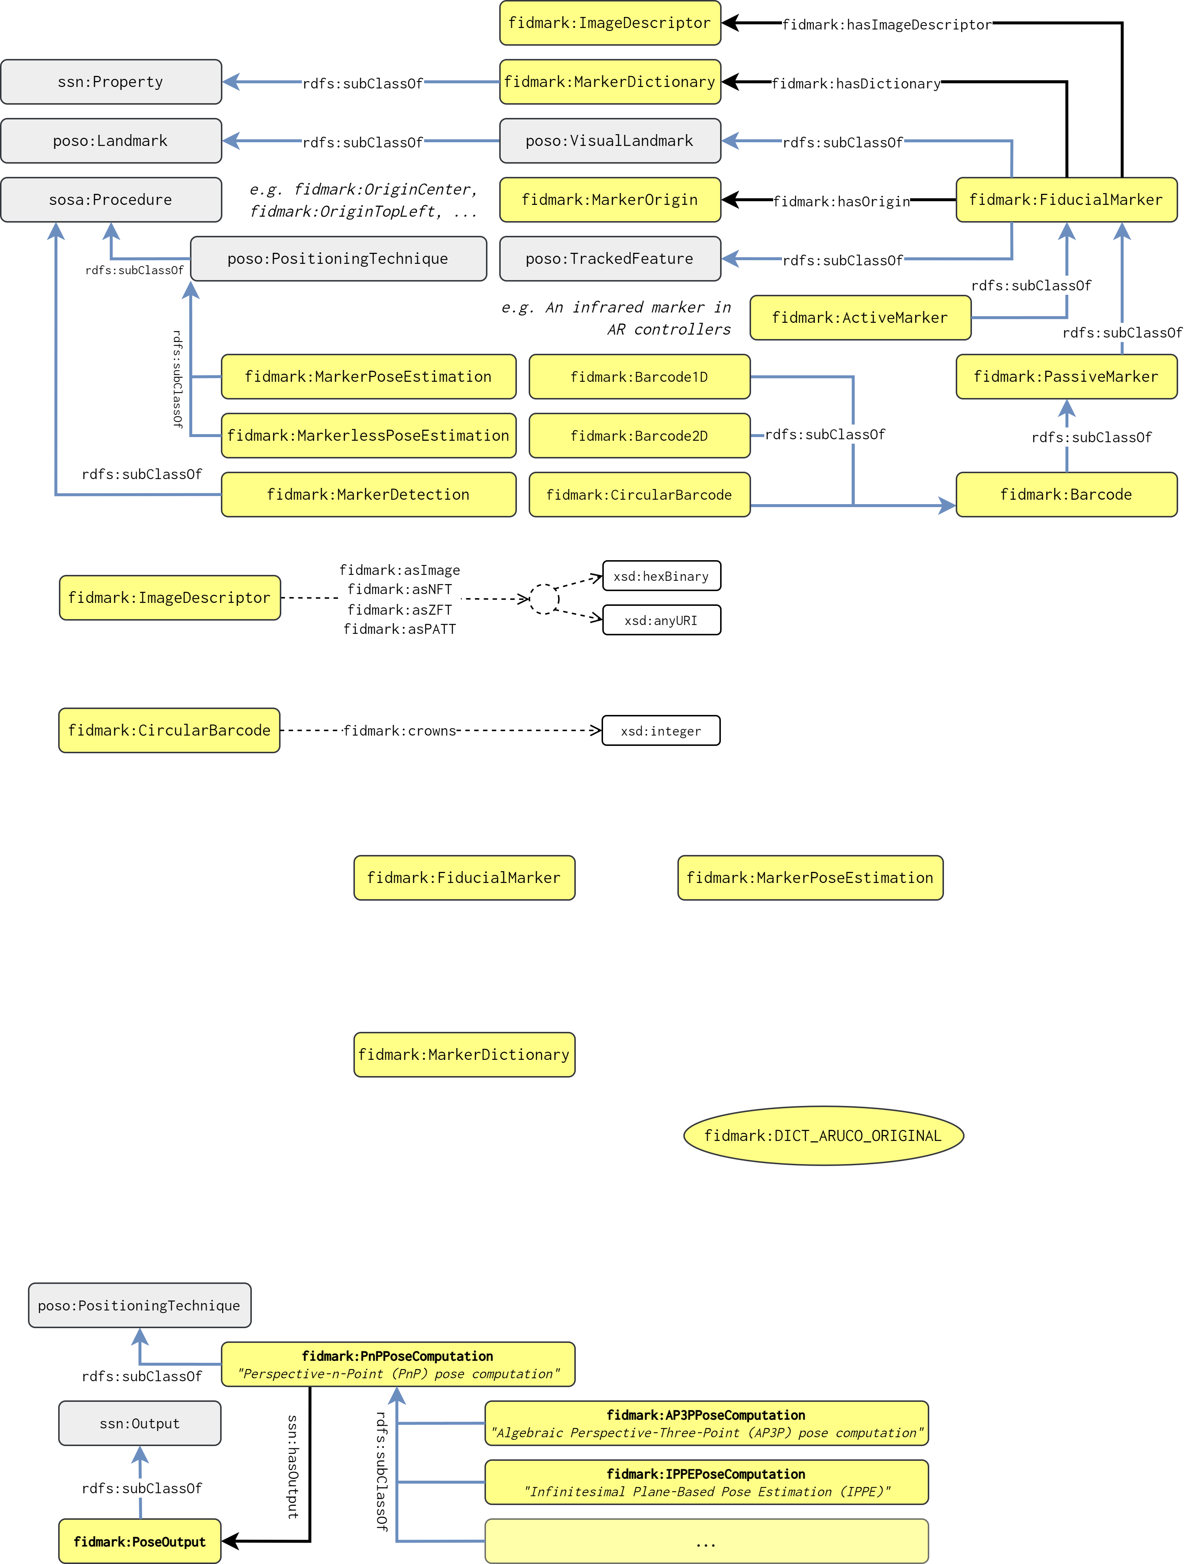
Main Classes

Slide 4
Main Classes…

Slide 5
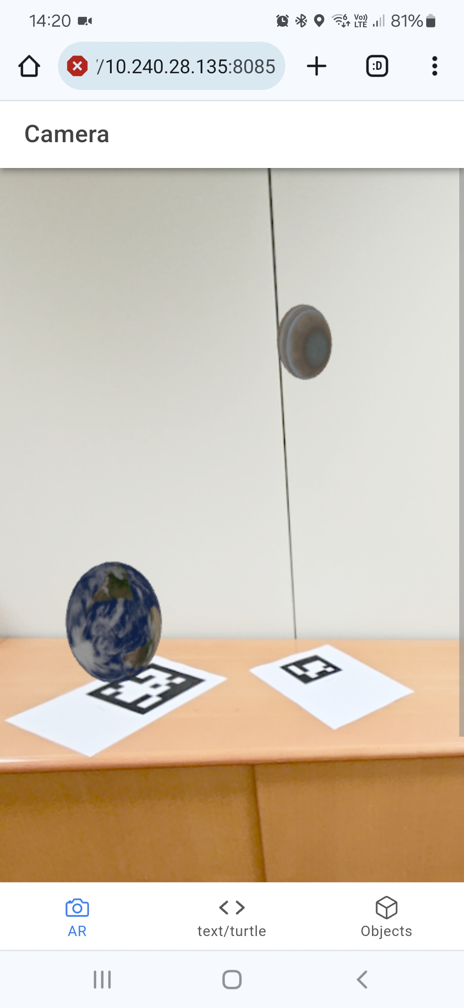
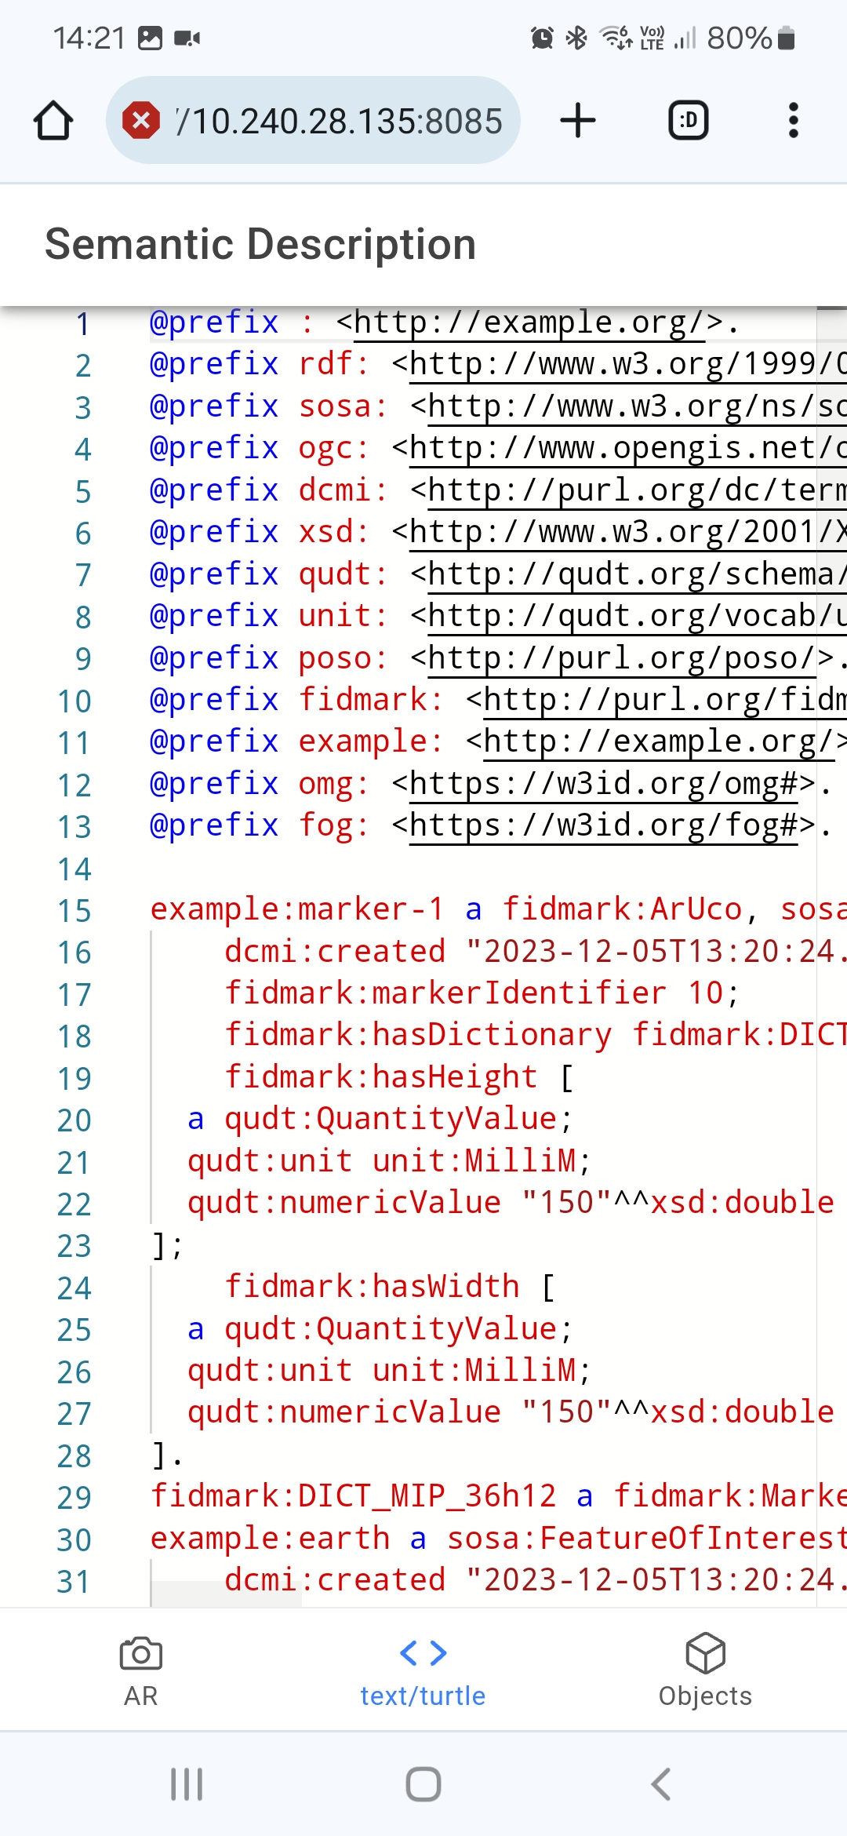
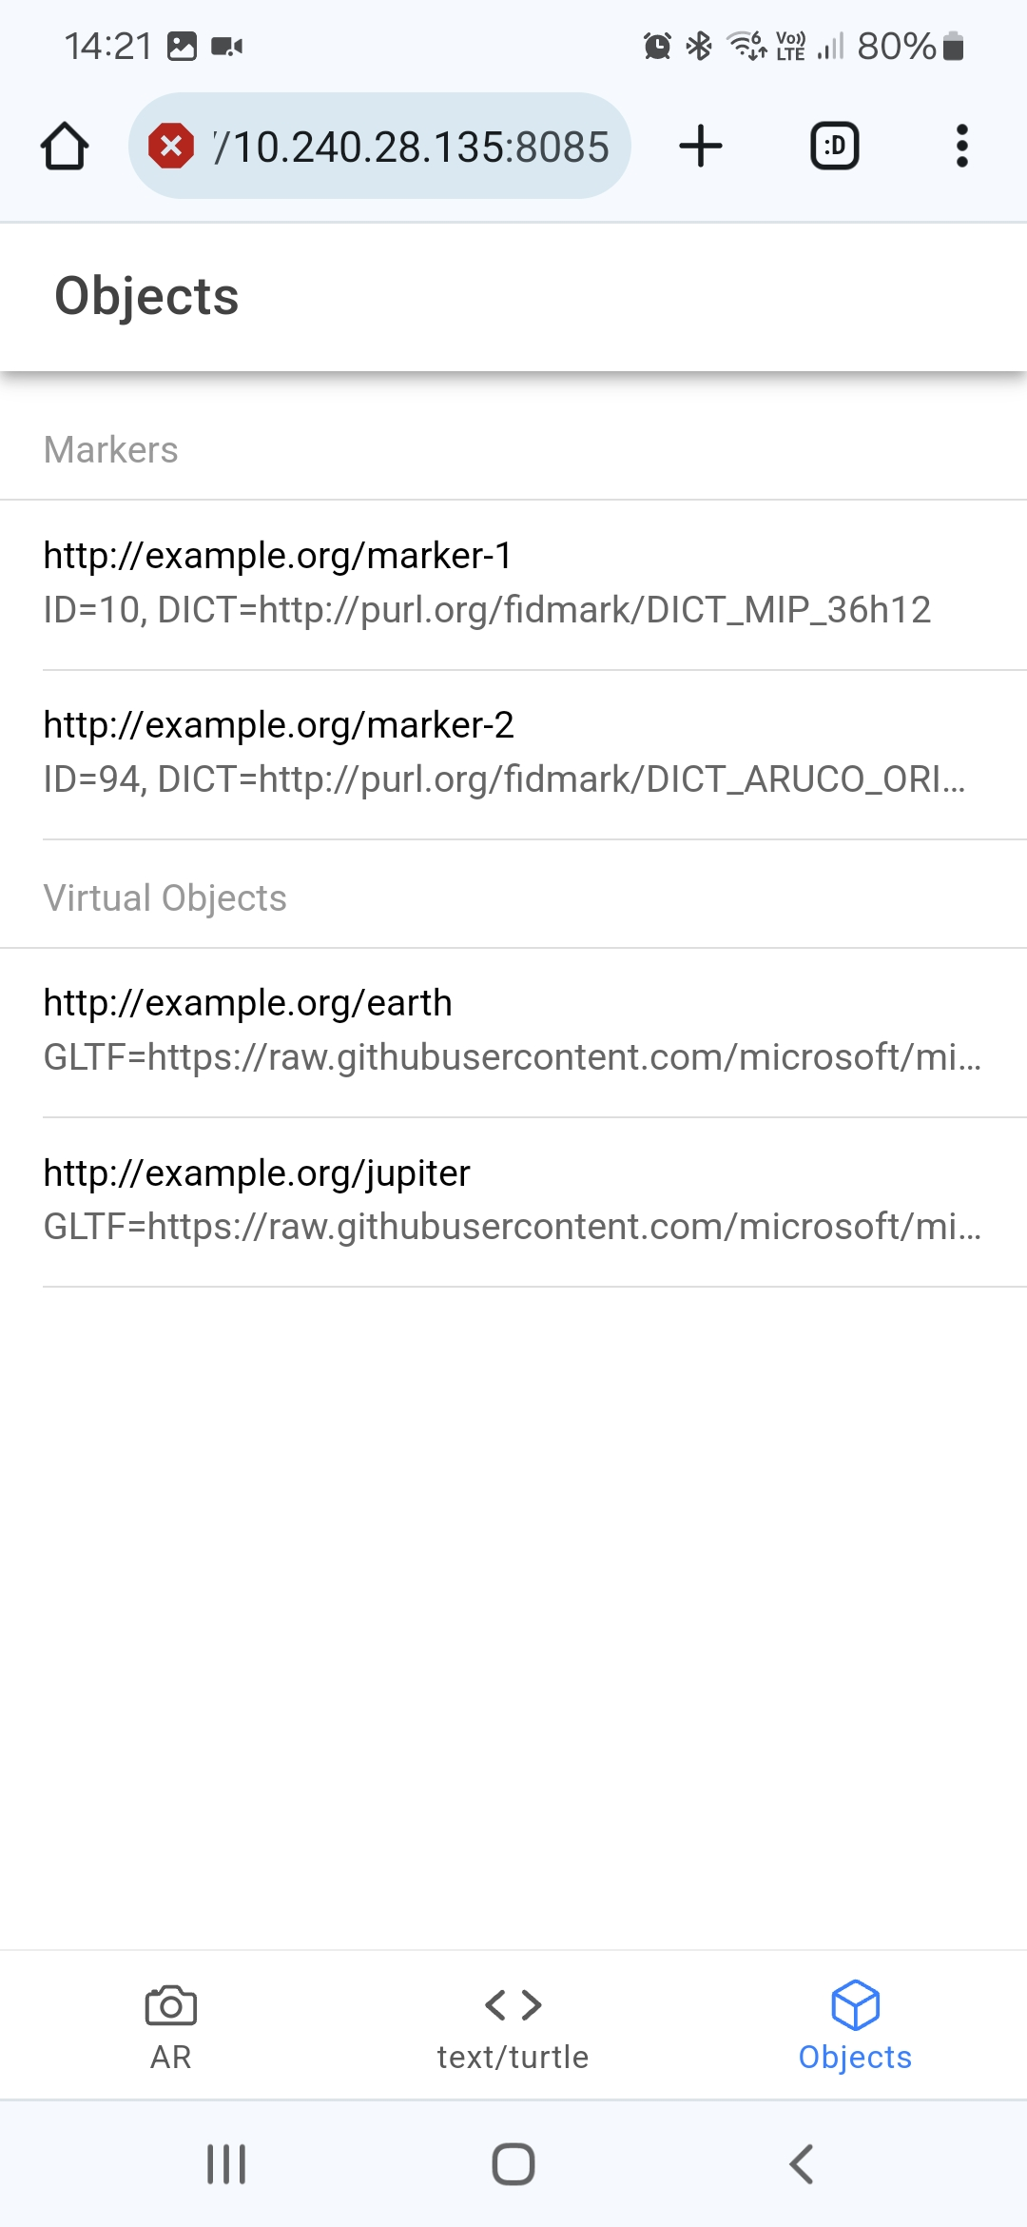
Demonstrator

Slide 6
Validation
OOPS! Validator

Slide 7
Conclusions and Future Work

